Slide 1
Coms 4995 – applied deep learning Course project
Fall 2022, Instructor: Joshua gordon
Andrew Schaefer

Slide 2
Goal & Purpose
Goal of class project: to build an end-to-end prototype that detects cancerous regions on gigapixel pathology images (from the CAMELYON16 dataset)
Prototype is inspired by the pathology paper discussed in class: https://arxiv.org/pdf/1703.02442.pdf
Purpose
Assist pathologists with identifying cancerous regions at a microscopic level
Reduce human labor and visual inspection
Potentially correct human error

Slide 3
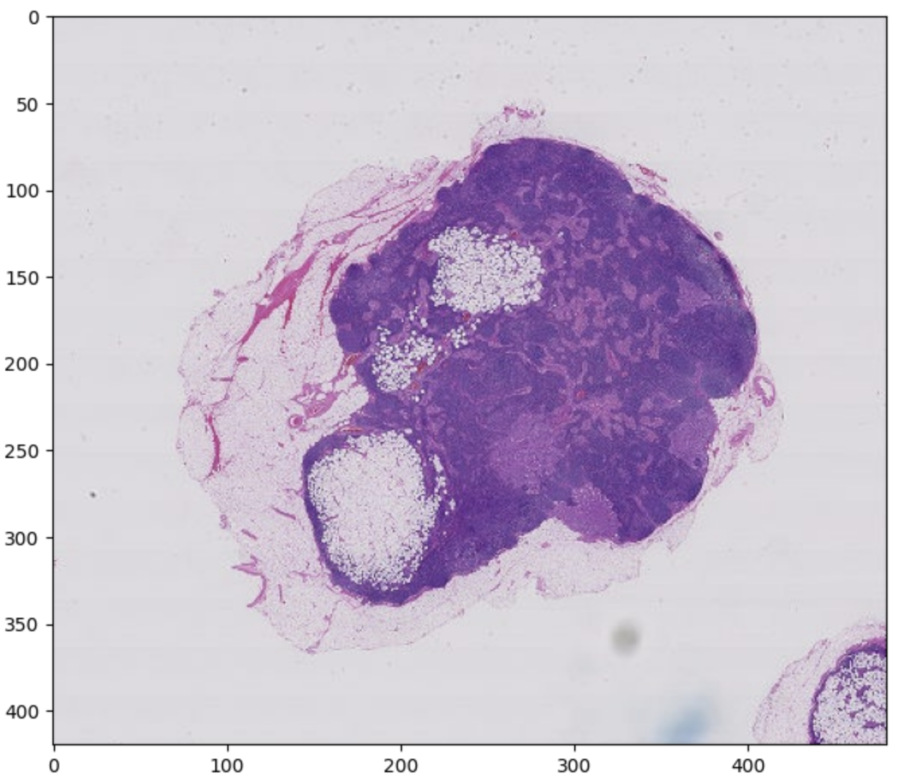
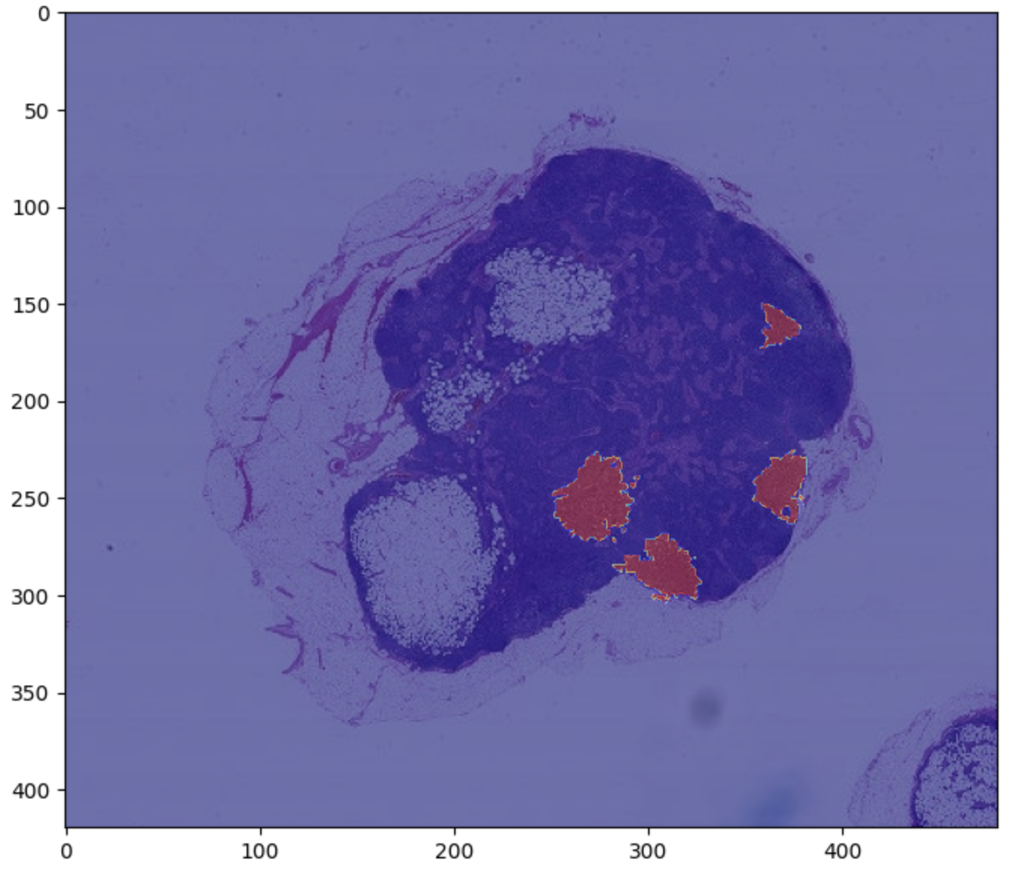
Data exploration
CAMELYON16 contains hundreds of slides, each 1 - 2 GB large (I used 7 slides for this project due to memory constraints)
Image resolution depends on the zoom level used
As expected, the dataset is highly imbalanced

Slide 4
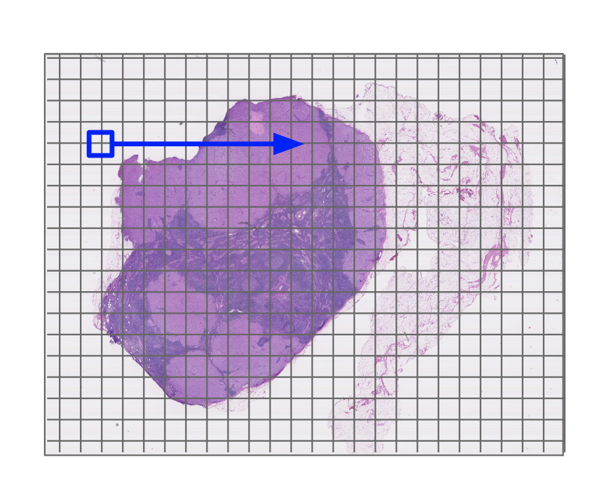
Strategy
As discussed in ADL lecture 4 and in the paper
Rather than do edge detection, we divide the gigapixel images into a grid and perform binary classification on each patch in the grid
Create grids at multiple zoom levels
Highlight regions that are predicted to be positive at all zoom levels
Allows us to classify portions of the image in batches rather than read the entire image

Slide 5
preprocessing
Extract patches that are sized 299x299 (padding added for edges)
Skip patches in the image that do not contain tissue
Performed data augmentation on the minority class in an attempt to combat the class imbalance

Slide 6
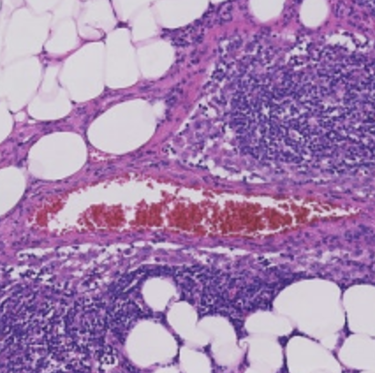
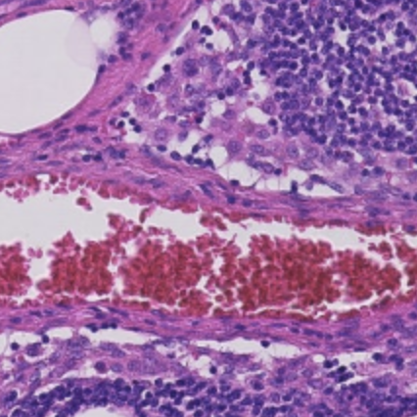
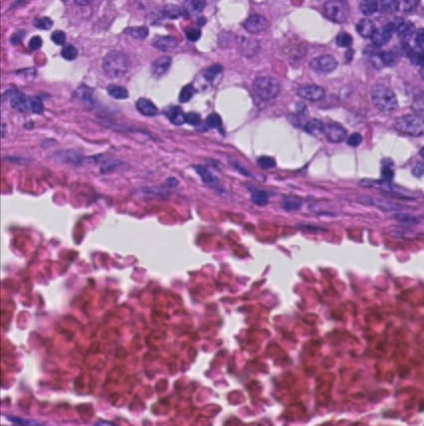
Architecture
heatmap
mask
(zoom 3)
mask
(zoom 2)
mask
(zoom 1)
Similar strategy in the paper
Train three InceptionV3 models, one for each zoom level
Trained on zoom levels 1, 2, and 3
Level 0 was skipped mostly due to time constraints (60-100k patches per slide)
Applied data augmentation on entire dataset to prevent overfitting
Construct the mask for testing slides containing predicted cancerous regions at each zoom level
Combine the masks to produce heatmap
InceptionV3
InceptionV3
InceptionV3
16x input
(zoom 3)
32x input
(zoom 2)
64x input
(zoom 1)

Slide 7
Code review
~ 5 minutes

Slide 8
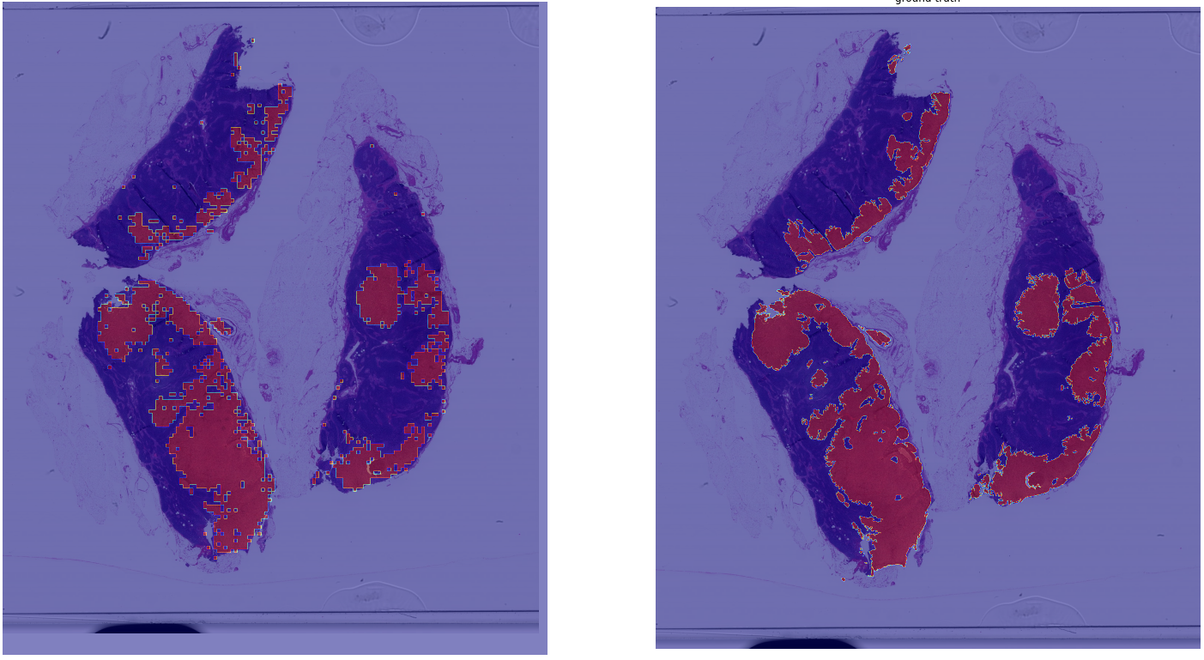
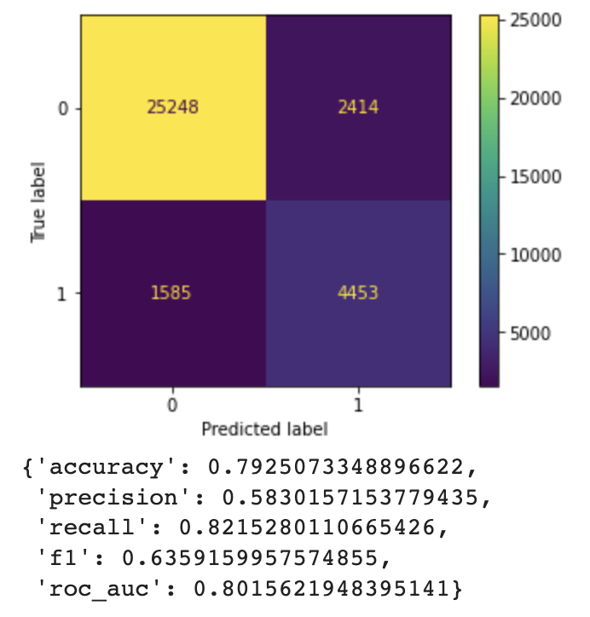
performance metrics and heatmap (first slide)
Averaged results across the Inception models
predicted
ground truth

Slide 9
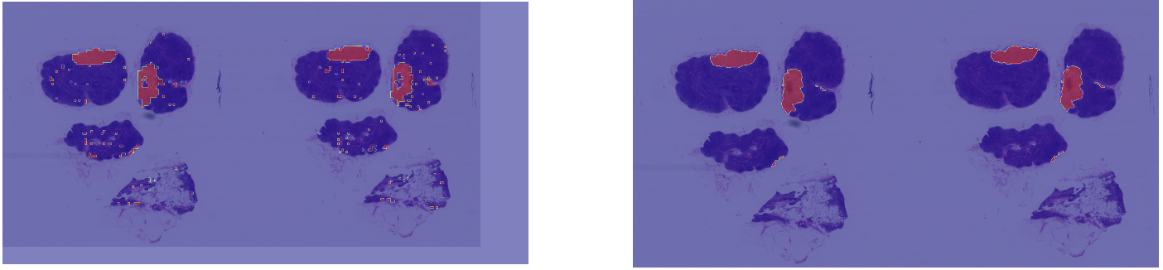
Heatmap (second slide)
predicted
actual

Slide 10
Potential improvements
Use more slides and zoom levels
Experiment with more data augmentation techniques
Experimented with other transfer learning models
Use smaller strides when saving patches (resulting in more data)
Experiment with CAMELYON17 dataset (contains more slides than CAMELYON16)

